Slide 1

Introduction: EventHub Platform
A comprehensive solution addressing fragmented event information across Bangalore's college circuit

Slide 2
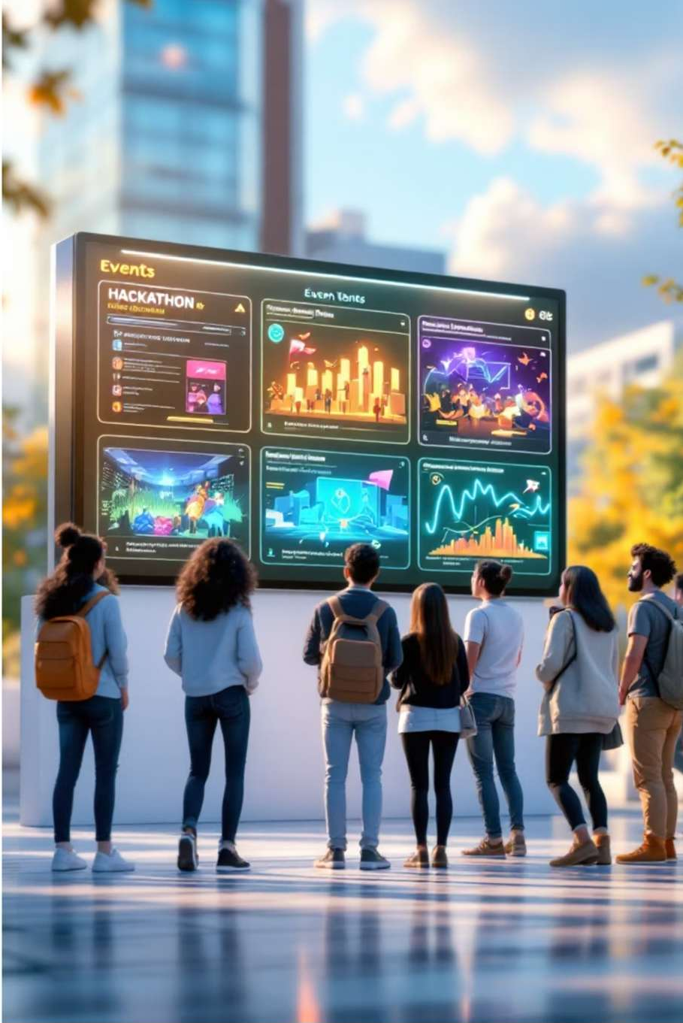
Abstract
EventHub.com addresses the fragmented event information problem across Bangalore's college circuit. This centralised platform empowers students to seamlessly discover, register for, and attend inter-college hackathons, cultural fests, and sports competitions. Featuring Google OAuth, filtered discovery, organizer dashboards, QR check-ins, and automated confirmations, EventHub.com fosters a more connected and engaged student community by simplifying event management and participation.

Slide 3
Literature Survey: Event Management Systems
A study of existing systems reveals crucial gaps in communication and coordination for college event management.
Traditional Manual Systems
Physical posters, notice boards, and word-of-mouth result in low participation and a lack of centralised data archives.
Existing Digital Portals
Internal college ERPs and WhatsApp groups create "siloed" information, preventing inter-college event discovery.
Social Media Platforms
Great for reach but lack structured registration, QR check-ins, tracking, and formal certificate generation for academic events.
Commercial Event Platforms
Generalised features and ticketing fees often don't suit the specific "college-to-college" synchronisation needed.
Closing the Gap with EventHub.com
Centralisation
A single-window access point for Bangalore's college circuit.
Automation
Digital registration, QR codes, and automated confirmations.
Analytics
Organiser dashboards for registration data and insights.

Slide 4


Background: The Communication Gap in College Events
The Challenge
The Impact
Students across Bangalore colleges frequently miss significant inter-college hackathons, cultural festivals, and sports competitions. Event information remains scattered across isolated internal portals, creating an information silo effect that limits participation and engagement.
Without centralised visibility, talented students lose opportunities to showcase their skills, network with peers from other institutions, and enrich their collegiate experience through diverse events.

Slide 5




Methodology: Solution Approach
To address the fragmented communication identified, we implement a three-pillared methodology designed to unify the college event ecosystem:
Centralised Discovery
Establishing a single-window portal that aggregates event data from all Bangalore colleges to eliminate silos.
Seamless Registration
Standardising the user journey through a unified interface for event discovery, registration, and attendance tracking.
Community Building
Creating a collaborative network that facilitates direct interaction between event organisers and the student body across institutions.

Slide 6

Design & Architecture: Implementation Roadmap
Planning & Design
Database schema definition and UI/UX wireframes for home
and event detail pages
1
2
Frontend Development
Responsive card-based layout with search and category filters
Backend & Database
API routes for event retrieval, Cloudinary integration,
registration logic
3
4
Unique Integrations
QR code generator and automated email confirmations
Testing & Deployment
Bug hunting across devices and hosting on Vercel, Netlify,
Render
5

Slide 7

Design & Architecture: Core System Architecture
1
User Authentication
Secure login via Google OAuth and email verification for students and organisers
2
Event Discovery Engine
Searchable, filtered feed displaying technical, cultural, and sports events
3
Organiser Dashboard
Private interface for clubs to post events and analyse registration data
4
Smart Features
QR-based check-ins, automated PDF certificates, and cross-college event map

Slide 8

Design & Architecture: Database Schema
Users Table
Events Table
Registrations Table
Name and email fields
College name attribute
Role classification
(Student/Admin)
Title and description
Date and venue details
Organising college and
category
User and event identifiers
QR status tracking
Timestamp recording

Slide 9
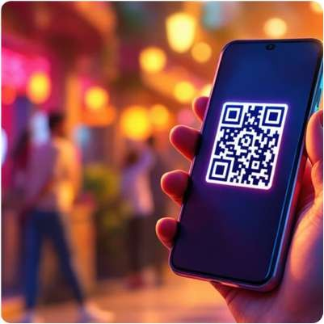



Results & Discussion: Key Features in Action
QR-Based Check-Ins
Students receive unique QR codes upon registration, enabling instant verification and streamlined event entry
Automated Email Confirmations
Instant email notifications sent to students upon successful registration with event details
Registration Analytics
Organisers access real-time data on participant numbers, demographics, and engagement metrics

Slide 10

Results & Discussion: Technical Implementation Highlights
01
02
03
Google OAuth Integration
Secure authentication system ensuring data protection whilst simplifying the login experience
Cloudinary Image Storage
Cloud-based solution for managing event posters, banners, and promotional materials efficiently
Nodemailer Automation
Automated email system sending instant confirmations and event reminders to registered participants
04
05
API Route Architecture
RESTful endpoints handling event retrieval, registration processing, and user management operations
Registration Logic
Intelligent system preventing duplicate registrations whilst tracking participant engagement across events

Slide 11

Results & Discussion: Impact Metrics and Student Engagement
100%
Event Visibility
Complete access to inter-college events across Bangalore's campus circuit
0 1-Click
Double Registration ^{Registrations} Streamlined process
Smart logic prevents from discovery to duplicate entries and confirmation in
ensures accurate minimal steps participant tracking

Slide 12


Conclusion: Building a Connected Campus Community
EventHub addresses the fragmentation of event information in Bangalore's college circuit. By centralising event discovery and streamlining registration through modern web technologies and innovative features like QR check-ins, the platform effectively bridges the gap between organisers and students.
The result is a more engaged, connected student community with unprecedented access to opportunities for learning, competition, and personal growth across institutional boundaries.

